Slide 1
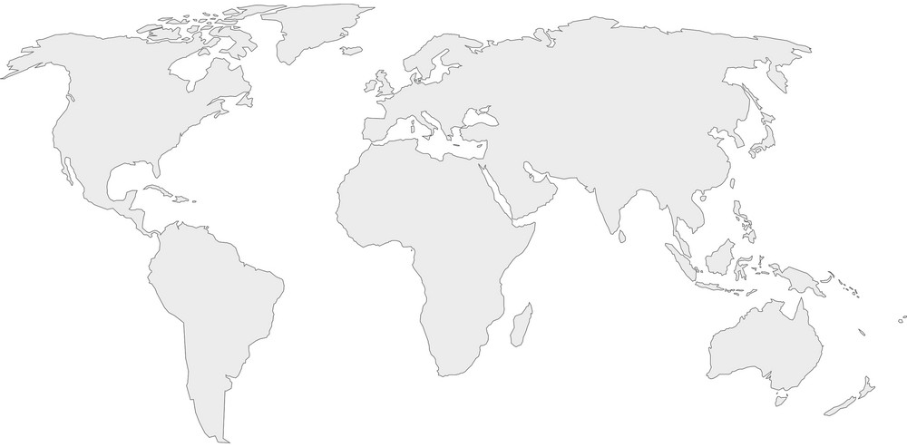
World Development Indicators Dataset
Source; World Bank via Kaggle
UCSD Week 6 Project
Steve Chevalier

Slide 2
Motivation
This dataset was select for the project for the following reasons;
It was a large dataset of world wide indicators of many types
The problem to solve was exploratory in nature. What could I learn from this data that covered the entire data set.

Slide 3
Research Question(s)
The question that came to mind was to find out what indicators had been reported through the entire range of years (1965 through 2015), who had reported them and how did they change over this 65 year span.

Slide 4
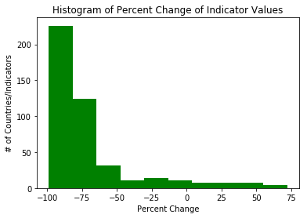
Findings
As the problem was to find the top 10 most changed indicators the visualizations where not all that interesting but the information was. All the interesting stuff was up against the left and right sides of this chart.

Slide 5
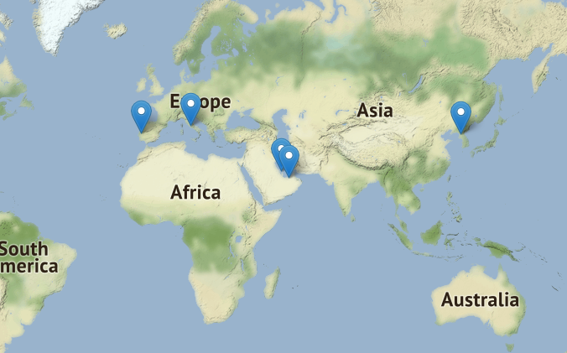
Findings
Locations of countries with largest change

Slide 6
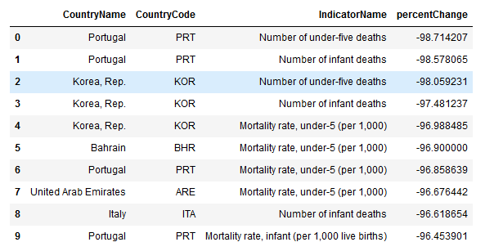
Findings – Top 10 Country/Indictors

Slide 7
Findings
All of the most significant improvements in the indicators are related to infant mortality rates
Improvements of this magnitude are significant especially when you consider what these numbers mean.
  If you just consider Portugal, the improvements represent 17,401 fewer infants died in 2015 than might have considering that over 17,652 where died in 2016.
  If you consider Togo, that had a similar infant mortality rate as Portugal but has not shown improvements. They still have about the about the same number of infants die each year (13,077, a slight increase).
Recommendations for further study.
  Exam the details of counties that showed the most improvement and try to determine best practices.
  Exam the circumstances of countries like Toga and see what best practices could be implemented.

Slide 8
Acknowledgements
I used only this dataset for the analysis.
My close friend and life partner was helpful in that we discussed aspects of this as I worked through this project and she had many questions that got me to go back and relook at what I had done.

Slide 9
References
I did not use other references.

Slide 10
Notebook
See Jupyter Notebook included in the same GitHub repository.

